Slide 1



12.03.2026
Launching and Pursuing an Integrated Strategic Approach to Open Science and Open Education at UCLouvain
UNESCO, CC BY-SA 3.0.
Depoterre Sophie, Desterbecq Joëlle, Gatto Laurent
October, 21st, 2026, Paris

Slide 2

Structure
The Evolution of UCLouvain’s Open Strategy
Why adopt an integrated approach to Open Science and Open Education?
Open Science and Open Education Initiatives
Main Challenges and Potential Leverages

Slide 3
The Evolution of UCLouvain’s Open Strategy

Slide 4
One objective, three strategic plans
🦠
COVID
2020
💻
🚀
🎯
2015
2021
2025
Horizon 600
Un cap, du sens
Université numérique
Plan d’action “Open Education & Open Science”
Lignes directrices institutionnelles en matière d’Open Science et d’Open Education
Experimentation phase
An Open Approach Supported by Digital Technologies
Objective: Using digital technology to promote the creation, dissemination, and acquisition of knowledge
Three Pillars: Open Education, Open Publication/Access, Open Source
Consolidation phase
Commitment to sustaining the open approach
Implementation of an “integrated” OS and OE strategy
Institutional leadership
Development of actions (training, support, etc.) and infrastructures
Addition of a fourth Pillar : Open Data and RDM
Stabilisation phase
Promote a fully Integrated Open Science and Open Education Strategy
Establishment of a Governance Structure and an Institutional Policy
Development of Studies to Support the “Open” Strategy

Slide 5
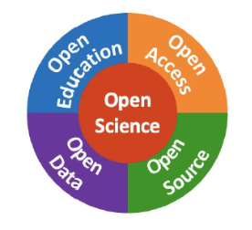
(Source : UCLouvain, Plan Horizon 600) ​
Why adopt an integrated approach to Open Science and Open Education?

Slide 6
Why an Integrated Approach ?
1
2
3
A single paradigm of openness
Research and teaching fall under one single openness paradigm, instead of two parallel policies.
A continuum of knowledge
Openness encompasses the entire knowledge chain: from the production of knowledge (data, publications) to its dissemination (teaching, MOOCs).
A shared culture
Common values, principles, tools and governance for the entire community: researchers, teachers and students.

Slide 7
A Single Paradigm of Openness
Open
Open Access to Knowledge
Use and Reuse
Modification, Creation
Sharing, Redistribution
The “Open definition”
“Open means anyone can freely access, use, modify, and share for any purpose (subject, at most, to requirements that preserve provenance and openness).”
Open Knowledge Foundation, “Open Definition”, https://opendefinition.org/

Slide 8
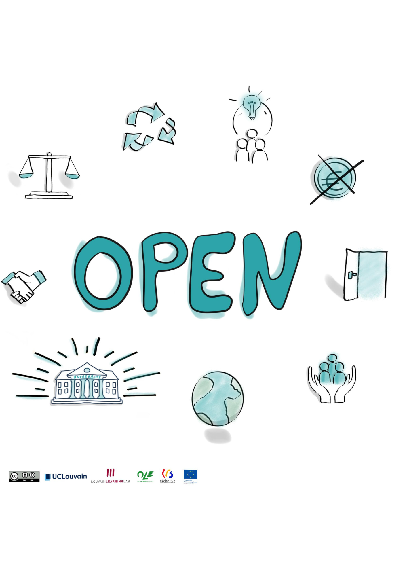
A Shared Culture (Principles and Values)
The Open movement is underpinned by values such as:
Ethics and scientific integrity
Equity, justice
Diversity, inclusion
Sharing
Collaboration, the common good
It is based on a set of principles:
Open access to knowledge
Use and reuse
Distribution and redistribution
Adaptation, creation
UNESCO, Une introduction à la recommandation de l’UNESCO sur une science ouverte, p. 8.
Sketchnote : Justine Fromentin, UCLouvain, Louvain Learning Lab, 2024.

Slide 9
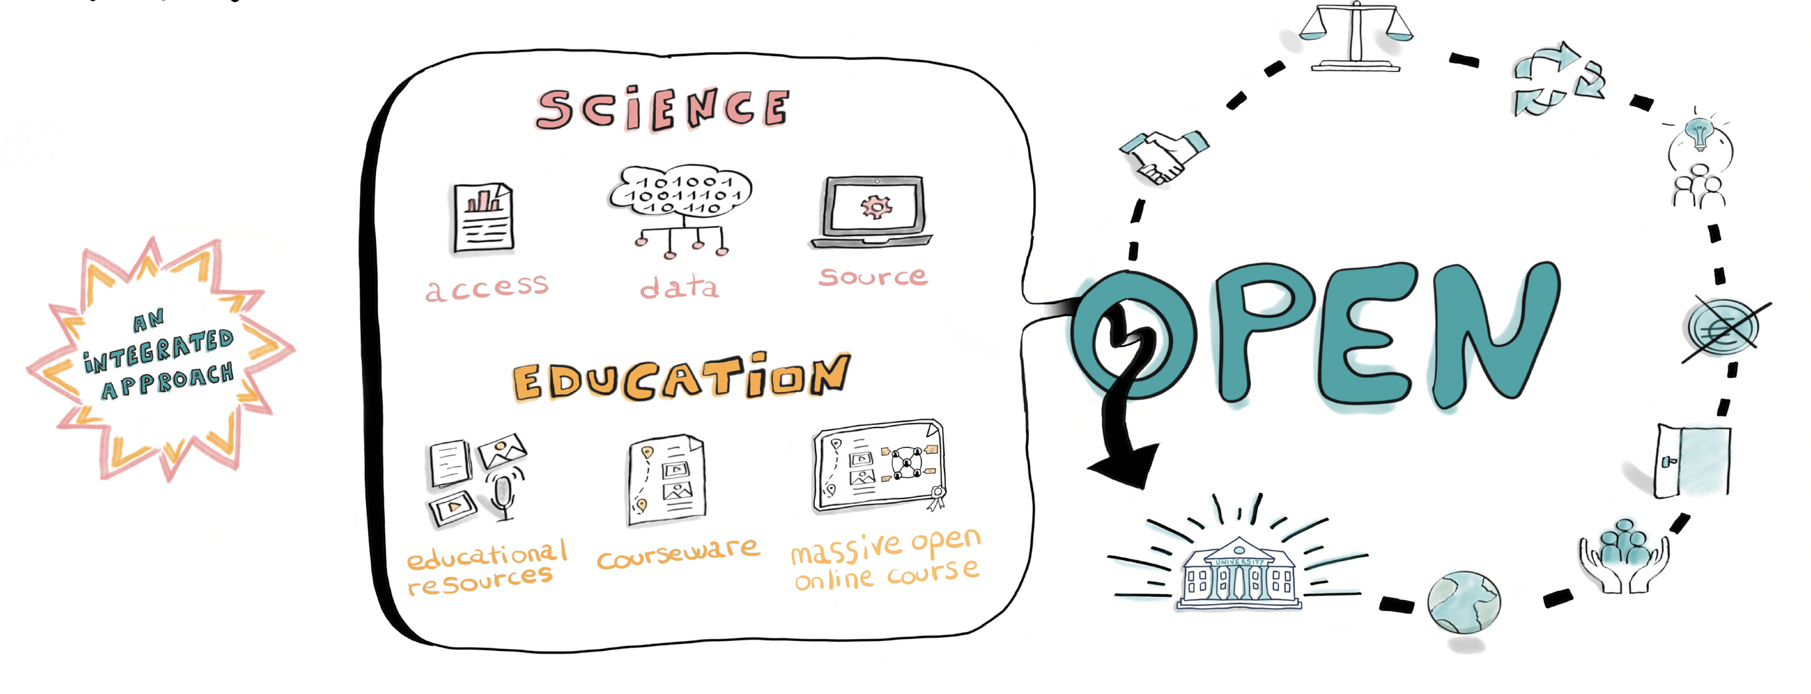
A Continuum of Knowledge
“Openness is a continuum: from producing knowledge to transmitting it — carried by unified values, principles, tools and governance”
Sketchnote : Justine Fromentin, UCLouvain, Louvain Learning Lab, 2024.

Slide 10
Open Science and Open Education Initiatives

Slide 11
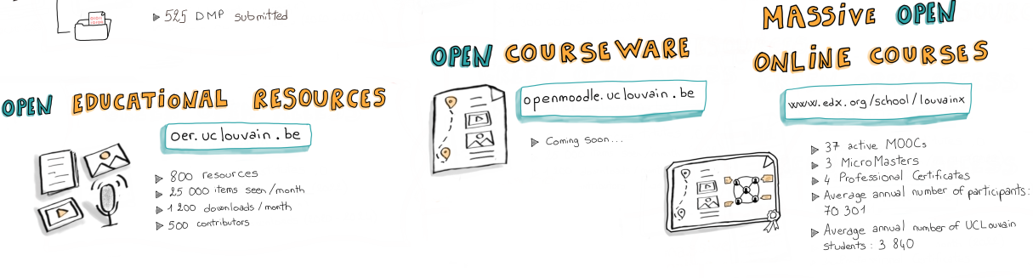
The Open Infrastructures (1/2)
Open Education
1st MOOC in 2013-14
34 active MOOCs
3 Micro Masters
4 Professional Certificates
70,300 learners / year (on average)
Incl.3,840 UCLouvain learners / year (on average)
Launched in 2017
Based on DSpace
950 resources
+ 500 contributors
87,000 visits in 09/26
1,700 downloads in 09/26
Launched in 2024
80 active courses
1300 active learners
110 active teachers
Adapté du sketchnote réalisé par Justine Fromentin, UCLouvain LLL, 2024, licence CC BY 4.0. Poster UCLouvain pour l’EOSC National Tripartite Event, 2024

Slide 12
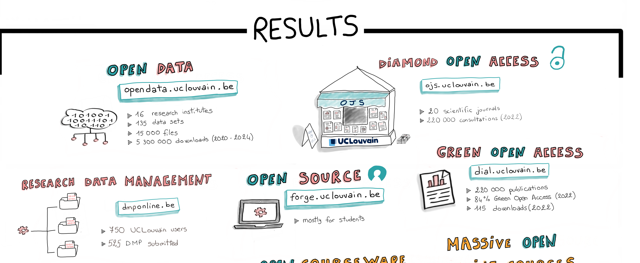
The Open Infrastructures (1/2)
Open Data, Open Access, Open Source
20 research institutes
227 data sets
27 924 files
6 573 000 downloads (2020-2026) at 21/10/26
23 scientific journals at 21/10/26
258 012 publications
67% open access (2018-2026)
1062 UCLouvain users
757 DMP submitted at 21/10/26
Adapté du sketchnote réalisé par Justine Fromentin, UCLouvain LLL, 2024, licence CC BY 4.0. Poster UCLouvain pour l’EOSC National Tripartite Event, 2024

Slide 13
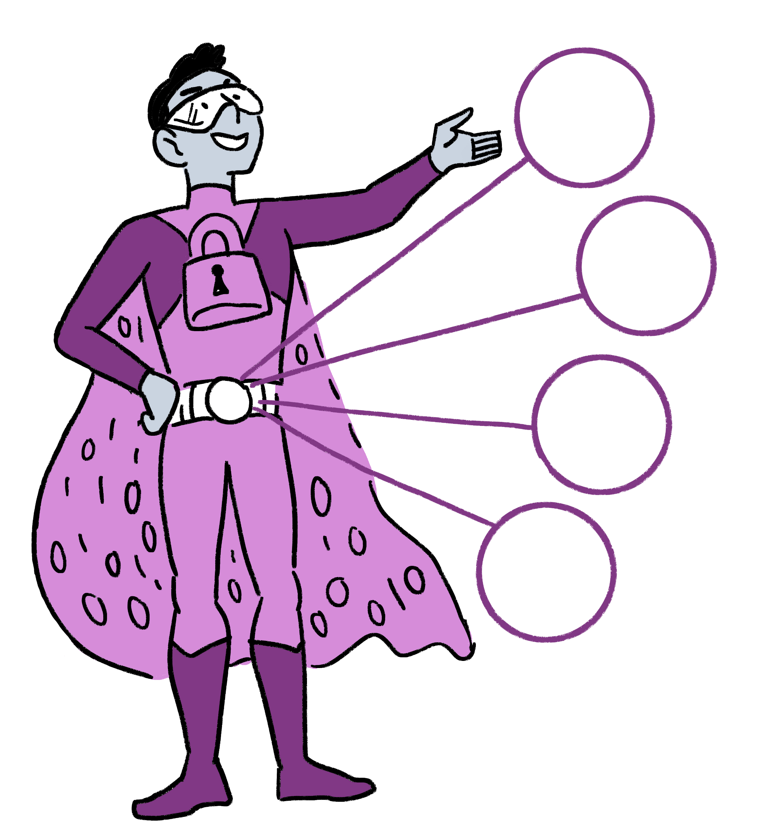

La communauté des DA aujourd’hui
Support for Open Science and Open Education
Advice and information :
  openeducation-lll@uclouvain.be
  rdm-support@uclouvain.be
  open-access@uclouvain.be
(Inter)national collaborations:
Joint Declaration on a Strategic Partnership for Open Education – fabriqueREL Québec, Nantes Université, UCLouvain
CRef, Open Access Belgium Network, FWB DA Network, …
Support (tailored to individual needs) :
  Share resources as OER, DMP, licenses and contracts, …
Training courses, including doctoral training :
  LLL Training Programme for teachers mainly, Libraries training catalog, doctoral course on open science
Research, strategy and foresight
Tools and resources :
  Open Science website
  LLL website and DIAL website
Illustration adaptée de The Turing Way Community, & Scriberia. (2020). Illustrations from the Turing Way book dashes [Figure]. Zenodo. https://doi.org/10.5281/zenodo.4323154, License CC BY.

Slide 14
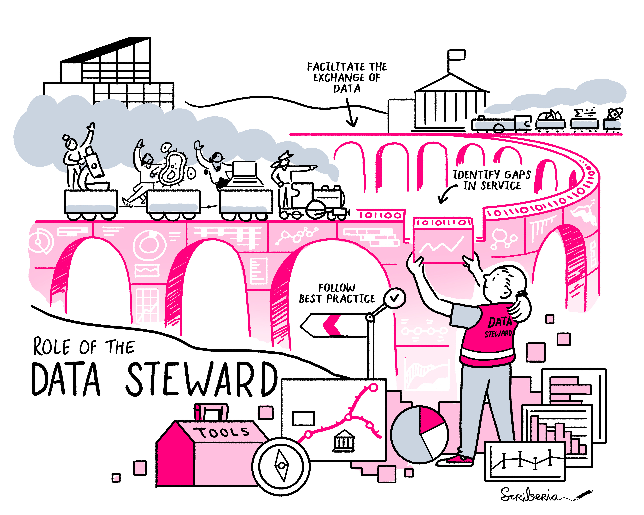
Complementarity - Central and Local levels
Example of the Data Ambassadors Community
Research institutes have appointed Data Ambassadors. Inspired by U. Cambridge, TUDelft
Objectives :
  To embed data management and “open” practices within their discipline and provide subject-specific expertise
  To engage dialogue with their Institution, to raise issues and to put forward proposals related to their discipline
Establishment of an inter-university network of data ambassadors across the universities of the French-speaking Belgian universities
  Exchange practices and share information
Figures :
  27 Data Ambassadors at UCLouvain
  More than 80 Data Ambassadors across the FWB universities
The Turing Way Community, & Scriberia. (2021). Shared under CC-BY 4.0 for reuse. Zenodo. https://doi.org/10.5281/zenodo.570631
https://pindare.cref.be/fr/thematique/data-ambassadors/

Slide 15
UCLouvain Institutional guidelines on Open Science and Open Education

Slide 16
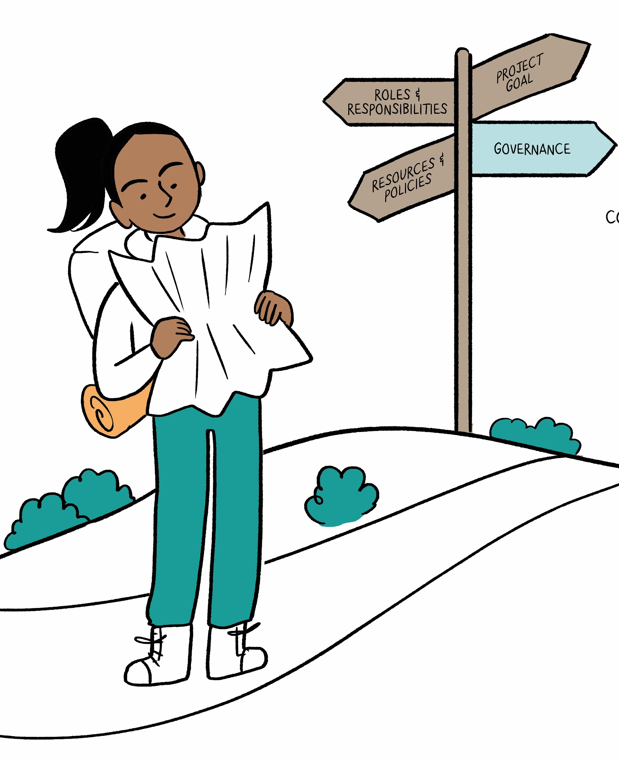

Institutional guidelines proposals : Key Areas
From Governance to Dissemination
The Open Science Steering Committee is currently drafting an institutional guidelines proposals on Open Science.
Consolidate the measures already undertaken, adjust some of them and promote new areas of implementation.
Integrated approach to OS and OE
Structured around the following components :
Specific actions for each component BUT a set of common objectives
Adapted from : The Turing Way Community, & Scriberia. (2024). Illustrations from The Turing Way: Shared under CC-BY 4.0 for reuse [Figure]. Zenodo. https://doi.org/10.5281/zenodo.13882307

Slide 17
Institutional guidelines proposals : Key Areas
From Governance to Dissemination
1
2
3
Governance & culture
To institutionalise the principles of open science across all research and teaching practices at UCLouvain; to foster a cultural shift.
Openness of research and educational outputs
A unified dissemination system covering all research outputs (data, publication, code, workflows, …); educational openness built on the same logic as research openness.
Empowerment of researchers and teaching staff
Working at early stage : Strengthening training programmes, workshops, … and doctoral courses ➔ with particular attention paid to early-career researchers.

Slide 18
Institutional guidelines proposals : Key Areas
From Governance to Dissemination
4
5
6
Centralised and decentralised (local) cooperation
Strengthen collaboration between the central institutional level and the local disciplinary level.
Recognition and assessment
Promote the recognition of open practices in researchers and academic careers.
Align Open Science engagement with research evaluation and career advancement (CoARA).
Institutional open infrastructures
Supporting the development and improvement of UCLouvain’s open infrastructure.

Slide 19
Institutional guidelines proposals : Key Areas
From Governance to Dissemination
7
8
Networks and collaboration
National and international collaboration; sharing of experiences; participating in initiatives and positions within UCLouvain’s partnerships.
Communication and dissemination
Develop a communication strategy showcasing Open Science people, tools and resources.

Slide 20
Main Challenges and Potential Leverages

Slide 21
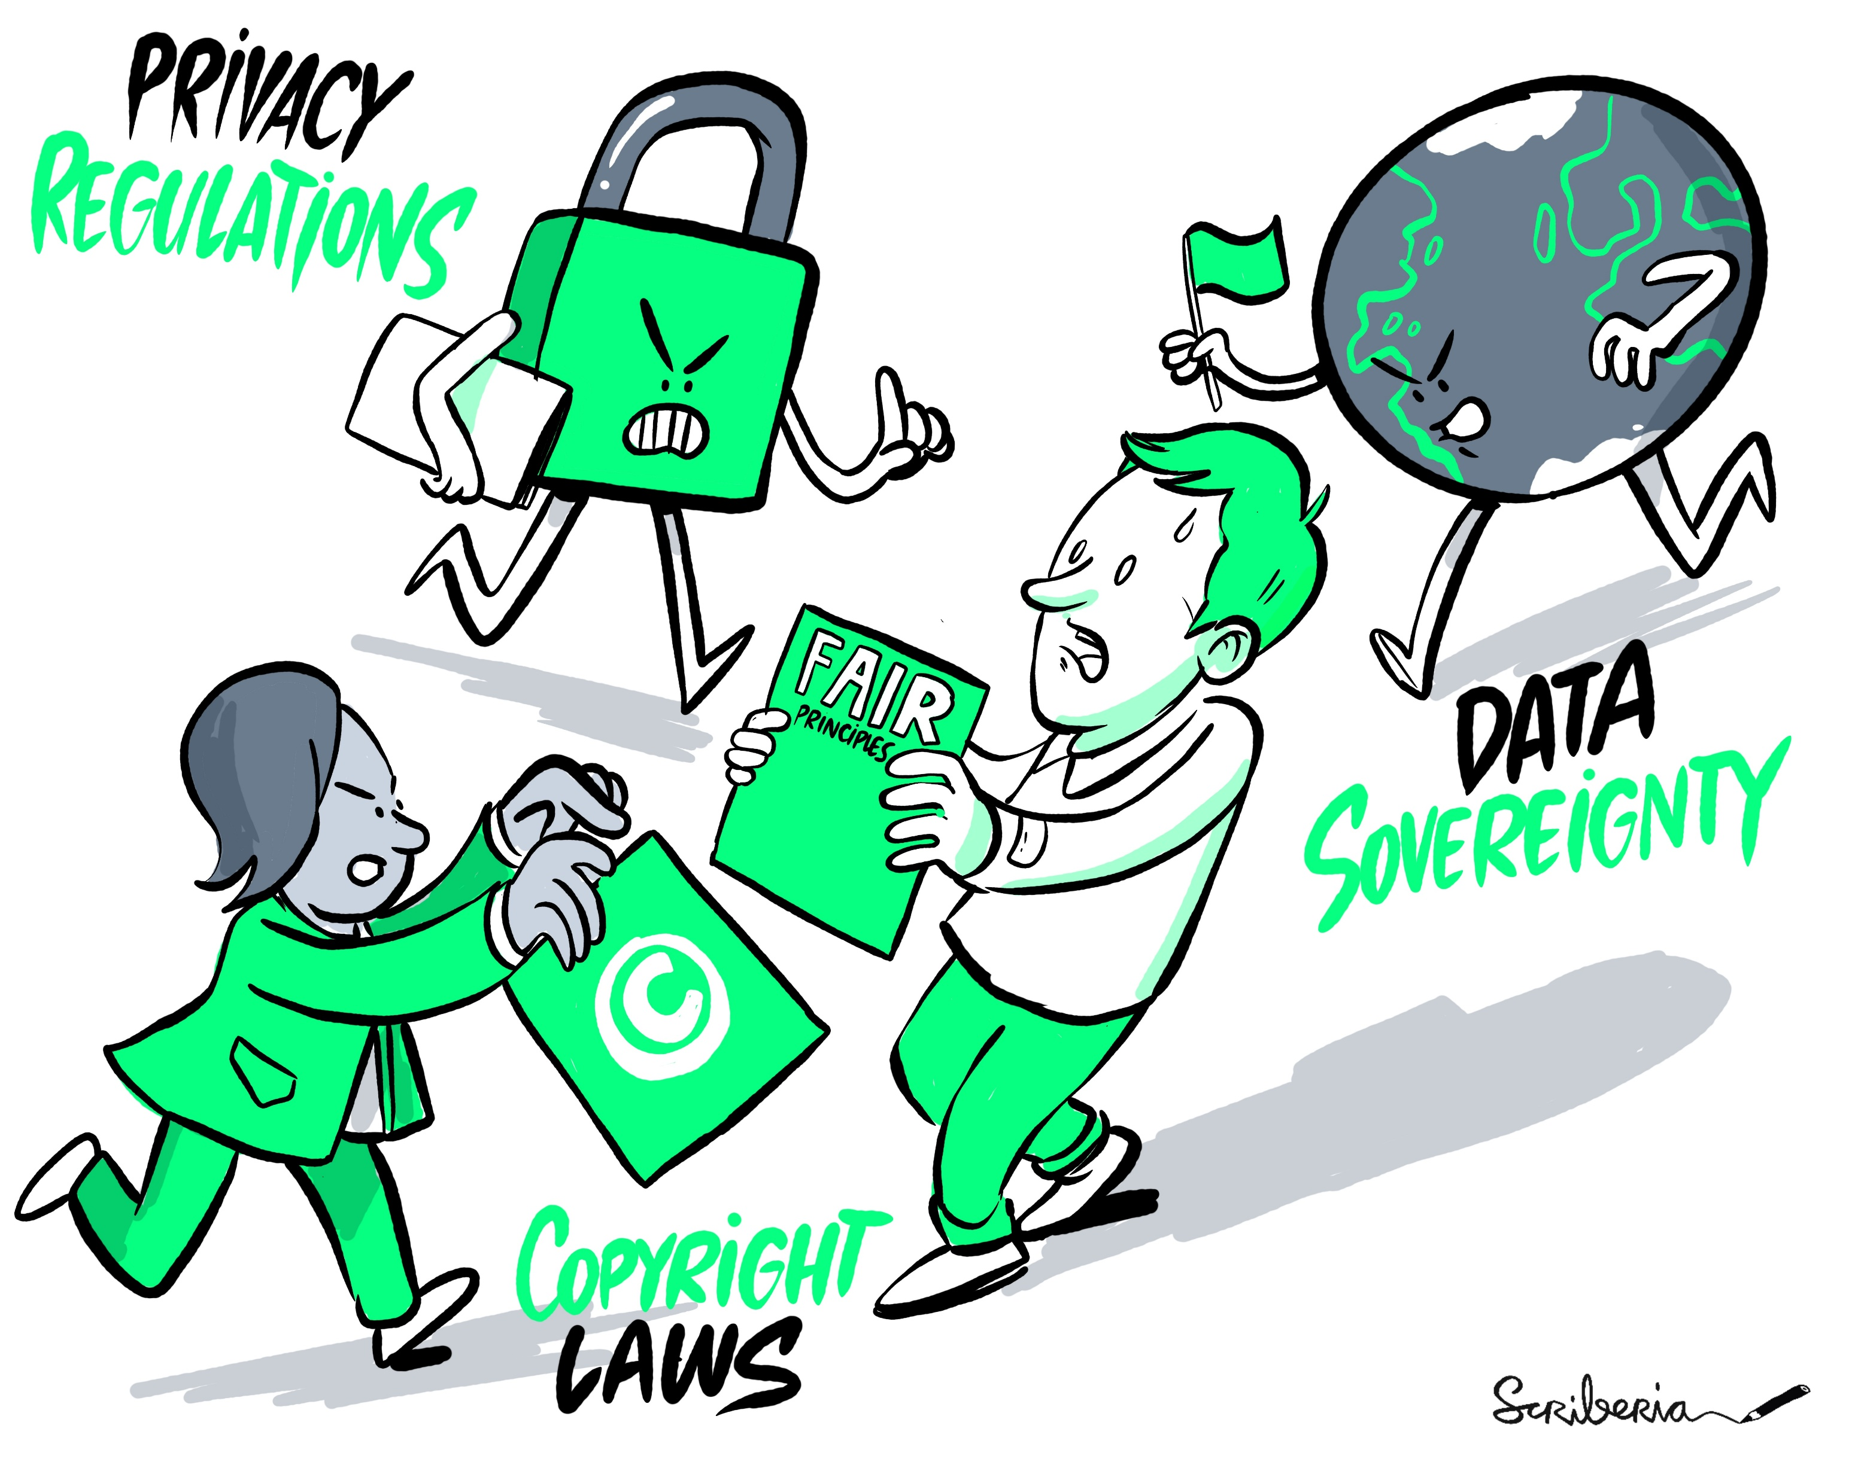
Main Challenges (1/2)
Resistance from certain members of the scientific community to the “philosophy/movement” of Open Science ;
Limited awareness of the individual benefits of Open practices (and RDM practices) ;
In the current international context, openness is increasingly being challenged by issues of sovereignty ;
Diversity of practices across scientific disciplines and cultures ;
Technical sustainability: who is responsible for the maintenance and monitoring of the platforms?
Thematic sustainability: who is responsible for supporting openness once the project has ended?…
The Turing Way Community, & Scriberia. (2022). Illustrations from The Turing Way: Shared under CC-BY 4.0 for reuse. Zenodo. https://doi.org/10.5281/zenodo.6821117

Slide 22
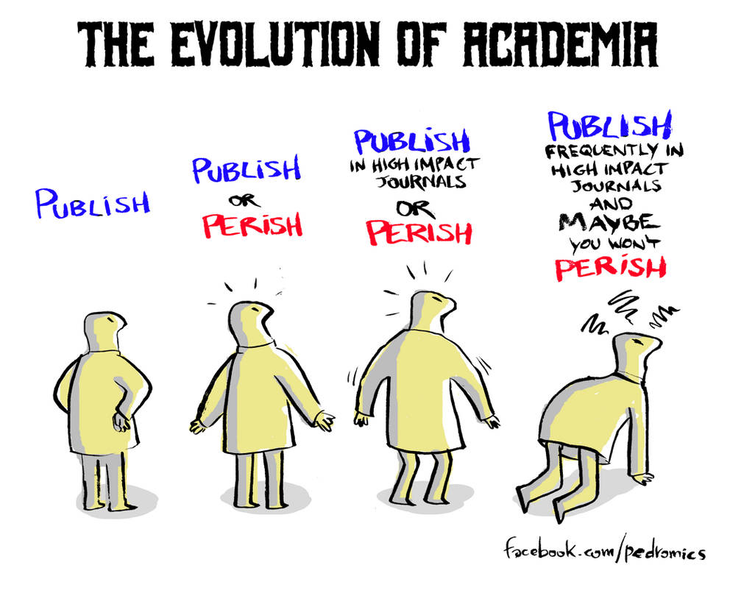
Main Challenges (2/2)
Increasing pressure to publish scientific articles ;
Linking open-access publication to article; processing charges (APC) (open = expensive!) ;
Perception of excellence of journals frequently associated with impact factor.
  High impact factor => high APC => financial difficulties linked to the perception of excellence;
Research assessment criteria still largely based on metrics (quantitative indicators).
https://www.deviantart.com/velica/art/Publish-or-Perish-645355248

Slide 23
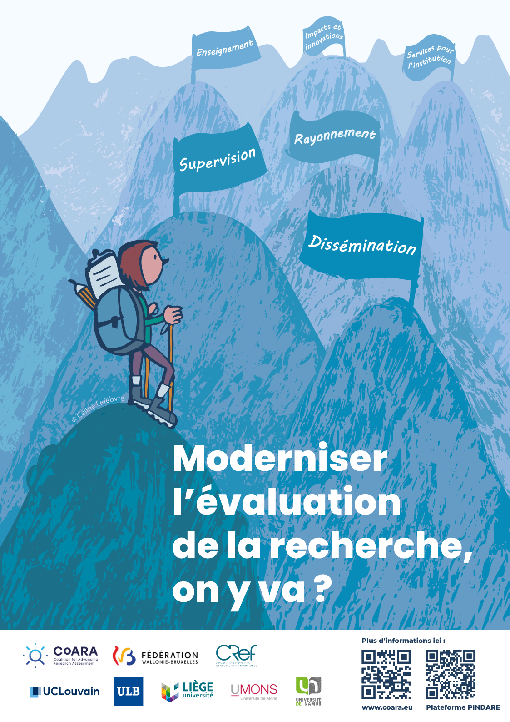
Potential Leverages
Research assessment : recognising open science practices in the evaluation of research projects and researchers’ careers
Changes in the recognition of pedagogical innovation in the evaluation of academic careers
Explaining how openness (data, code, etc.) is a matter of scientific integrity ;
Talk about ‘ethical’ publication rather than ‘open’ publication to change the mindset
  Is an APC of $11,000 paid for with public money ethical?
Explain that open access is also a matter of power: enabling the scientific community to regain control over its research and teaching outputs;
Ensure the long-term sustainability of the ‘open’ approach within universities (institutional policy, human resources, etc.).
Affiche réalisée par Céline Lefèvre, UCLouvain, 2025 dans le cadre du projet CoARA en FWB.

Slide 24
12.03.2026
Thank you !
https://uclouvain.be/fr/lll
https://uclouvain.be/openscience
sophie.depoterre@uclouvain.be
joelle.desterbecq@uclouvain.be
laurent.gatto@uclouvain.be

